Slide 1
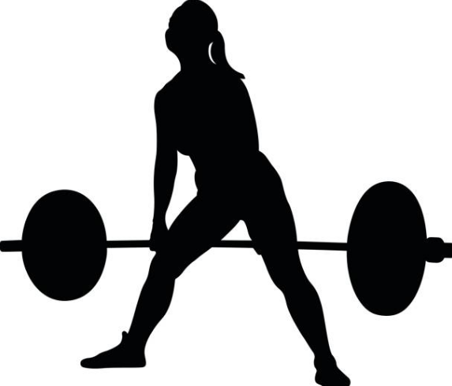
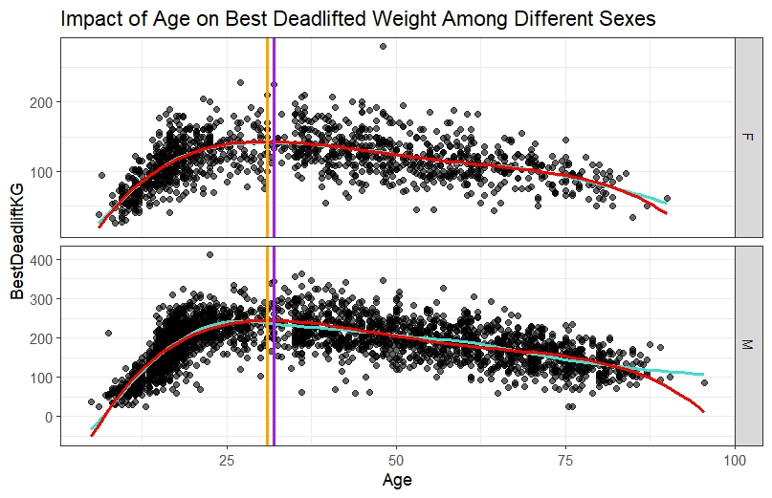
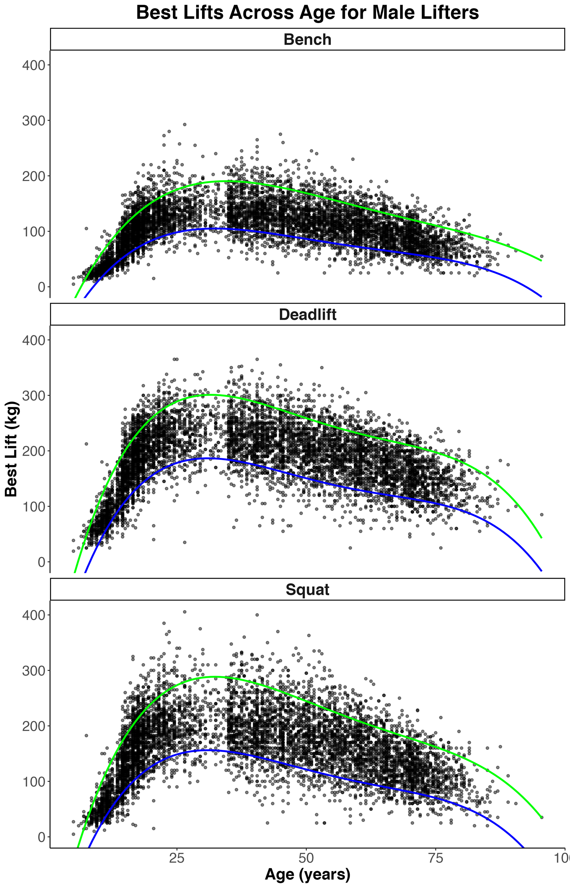
Modeling the Impact of Age on Powerlifting
Sarah Sheldon '25 (Statistics) and Joshua Larson '25 (Mathematics)
Advisor: Dr. Ivan Ramler
Department of Mathematics, Computer Science, and Statistics
Age vs. Strength by Sex
Score
Age vs. Strength by Status
The goal of this module is to create a model use Age and Sex as predictors for BestDeadliftKg.
We want to see if Age has an effect on the heaviest weight lifted for a contestant.
Funded by the National Science Foundation with the goal of promoting statistics and data science education using sports data.
Modules are created by faculty and students to be used as classroom tools.
Josh Module:
Goal: Model how Age impacts strength performance in elite vs. non-elite lifters.
Model: Quantile Regression
4th order polynomial
90th percentile = elite
10th percentile = non-elite
Powerlifting
Powerlifting is a strength sport where competitors in the same weight class compete to lift the heaviest weights in squat, bench, and deadlift.
Competitors use different types of equipment depending on the division: single or multi-ply wraps, sleeves, or nothing (raw).
Operation: Judge will give specific commands tailored to each lift, and the lifter is required to follow them to receive approval from all 3 judges.
Data is still recorded even if a lifter doesn't finish or is disqualified.
Students will establish 4th order polynomial graphs for each sex.
Using the graphs, they will determine the peak values of the curves and compare between sexes.
This will give insight into which age results in the maximum weight lifted for each sex.
Students will be introduced to the concept of indicator variables (for Sex) and choosing which polynomial model best fits given the two different curves.
The conclusion should be that the highest order gets chosen.
Future Work:
Introduce lifespan double exponential model as an introduction to the topic of non-linear regression as a way to model data.
Data Processing
Data was taken from an archive named openpowerlifitng.
The original data set had over 3 million rows
To reduce the number of rows, we:
Got rid of any missing variables.
Filtered out lifters that didn’t place.
Filtered to one competition (SBD) with two different equipment types (Raw, Single-ply).
Took a random sample of 500 lifters per Age group.
Lowered from 3 million to around 4000.
Analysis:
Elite lifters develop faster than non-elites.
Both groups peak between ages 24–35.
Decline occurs at a similar rate for both.
Key difference lies in the developmental phase.
Future Work:
Model individual lifters (multi-level).
Explore: What predicts elite status?

